Slide 1


/01
Residential
Q. Project Name
9. What is the property type
Estelle Darcy
Studio
Project brief | DD MM YYYY
www.thelivedesignproject.com

Slide 2
/02
Location
Design fees
Q. Project Name
City
Country1
<< This data is filled by Admin
Scope of work
Webinar date
11. Space to be designed
Q. Area m2
<< This is webinar Time Which is filled by Admin
WWW.THELIVEDESIGNPROJECT.COM
Project brief | DD MM YYYY

Slide 3
Project Brief | DD MM YYYY
/03
The
Client.
Situation:
Age:
Number of people leaving in the space:
Number of kids:
Pet:
www.thelivedesign.com
Current situation
Situation:
Age:
Number of people living in the area:
Area/s:
Number of kids:
Pet:
10. What best describes your situation1
5. How old are you1
12. How many people will leave in the space1
11. Space to be designed
13. Kids1
14. Do you have any pets1

Slide 4



/04
Scope of work
16. Please describe the scope of work
Client
Brief.
22. Is there any other information…
Project Brief | DD MM YYYY
Mood & Feel
15. What words describe best the mood and feel

Slide 5
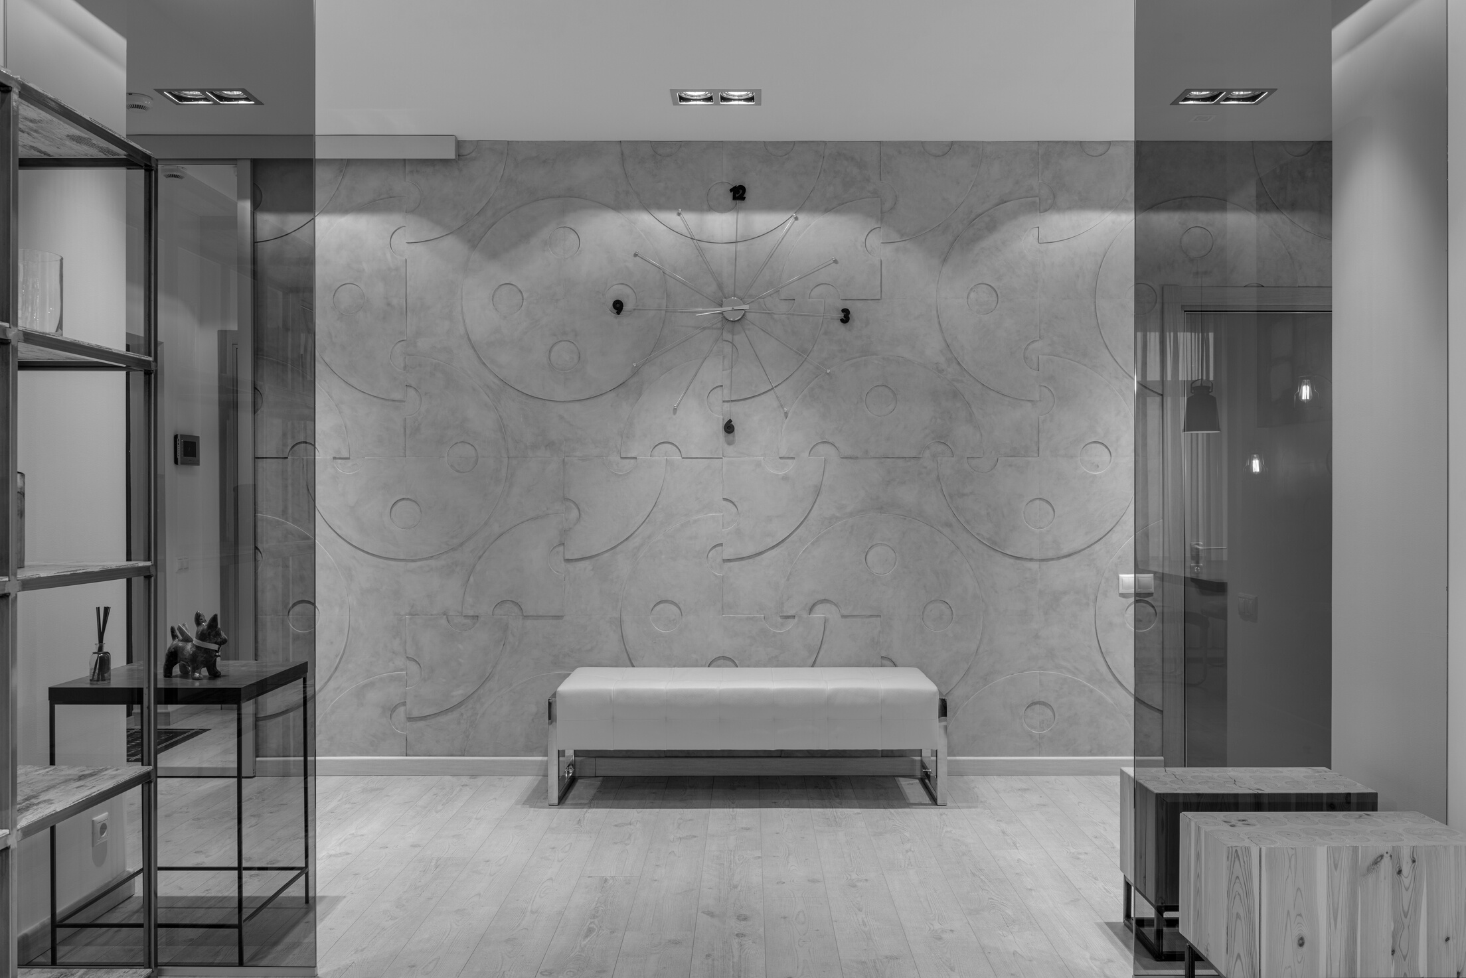
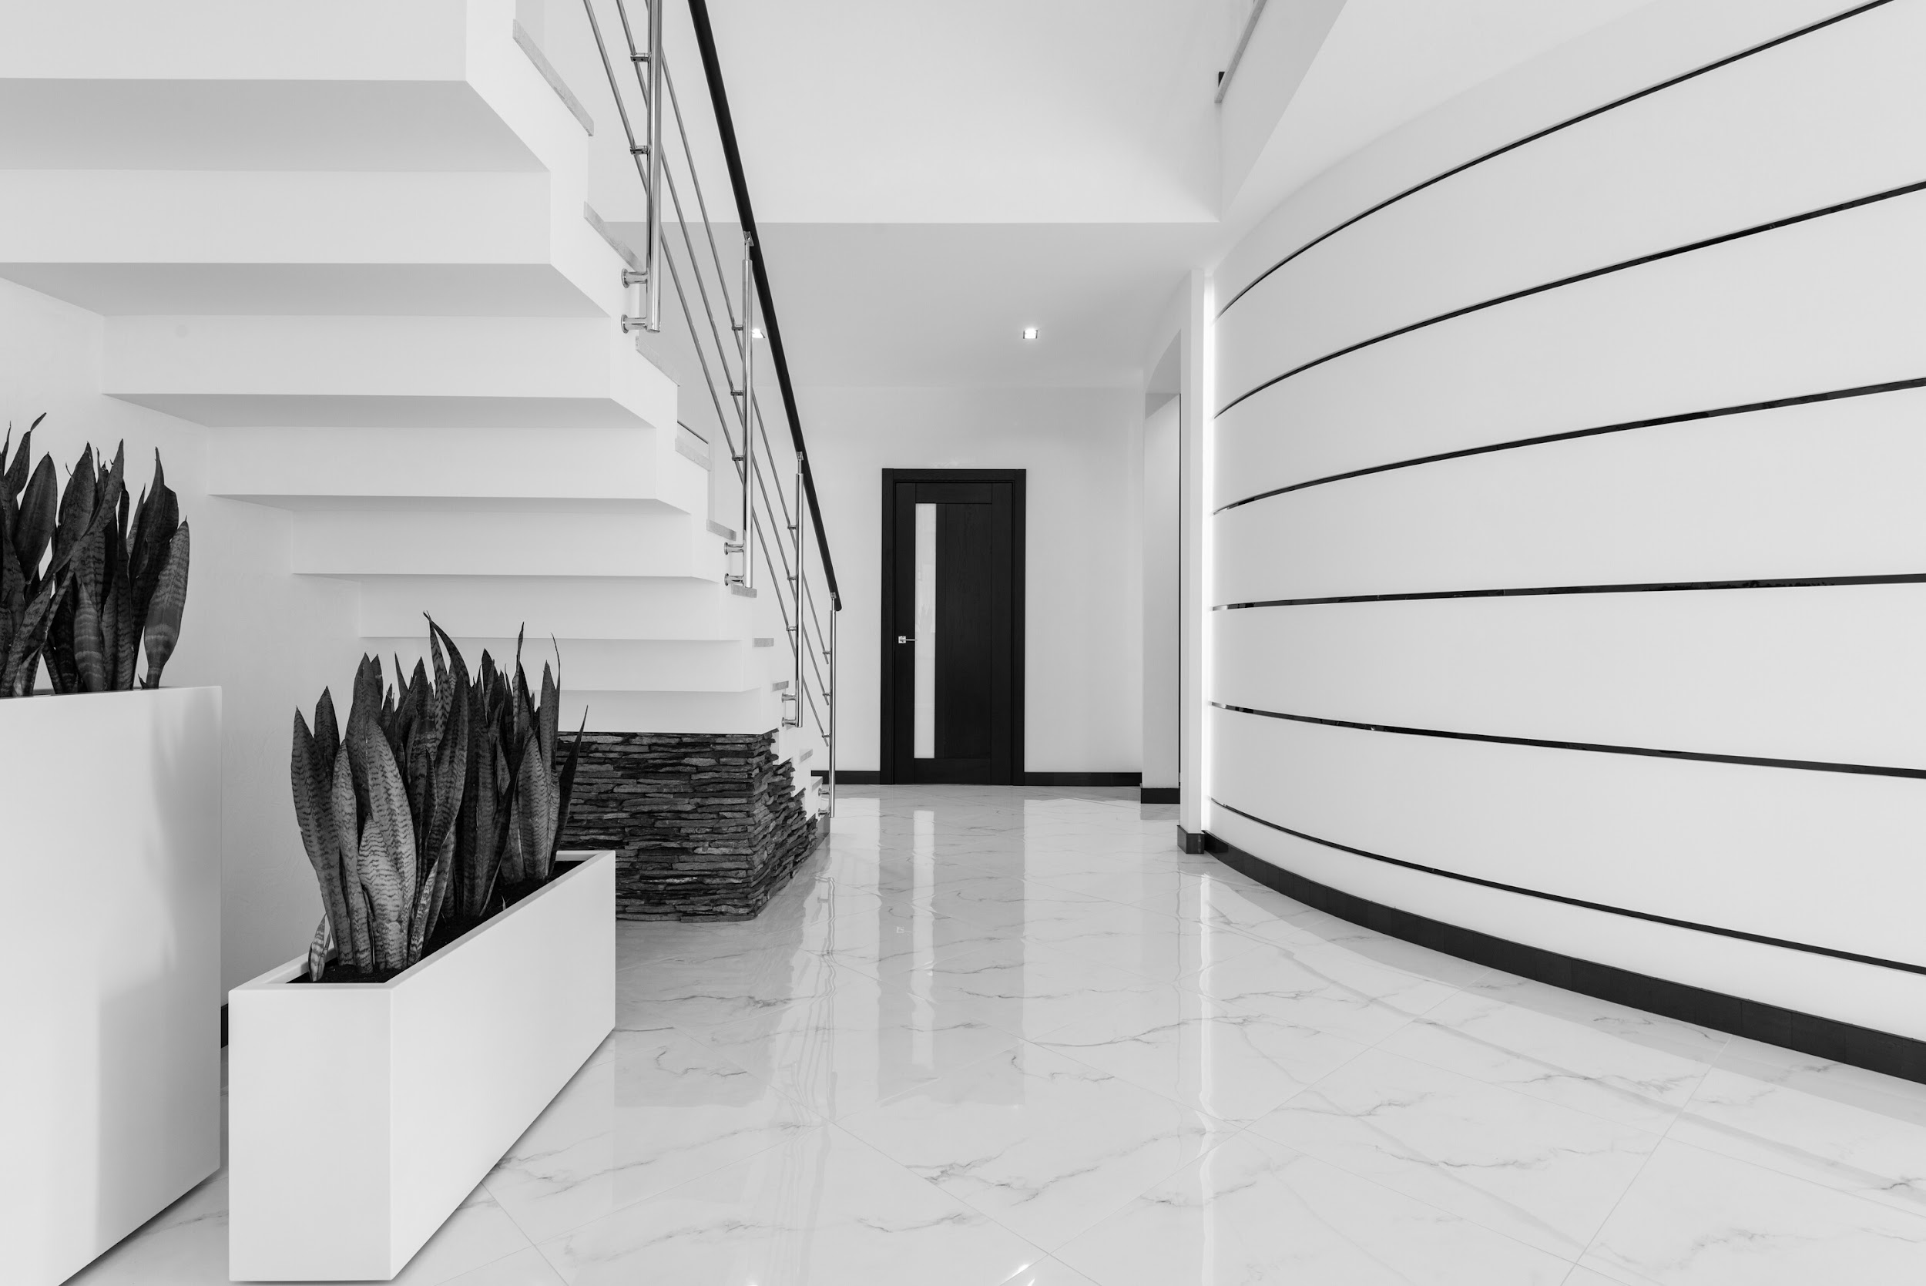
/NO.
Furniture:
By Admin
By Admin
By Admin
Lighting:
By Admin
By Admin
By Admin
Softs: Fabric / Carpet / Curtain:
By Admin
By Admin
By Admin
Sanitaryware:
By Admin
By Admin
By Admin
Kitchenware:
By Admin
By Admin
By Admin
Deco:
By Admin
By Admin
By Admin
Ref
FF&E.
Project Brief | DD MM YYYY

Slide 6
/NO.
Floor Finishes:
By Admin
By Admin
By Admin
Wall Finishes:
By Admin
By Admin
By Admin
Carpentry Finishes:
By Admin
By Admin
By Admin
Other:
By Admin
By Admin
By Admin
Other:
By Admin
By Admin
By Admin
Other:
By Admin
By Admin
By Admin
Ref
FF&E.
Project Brief | DD MM YYYY

Slide 7
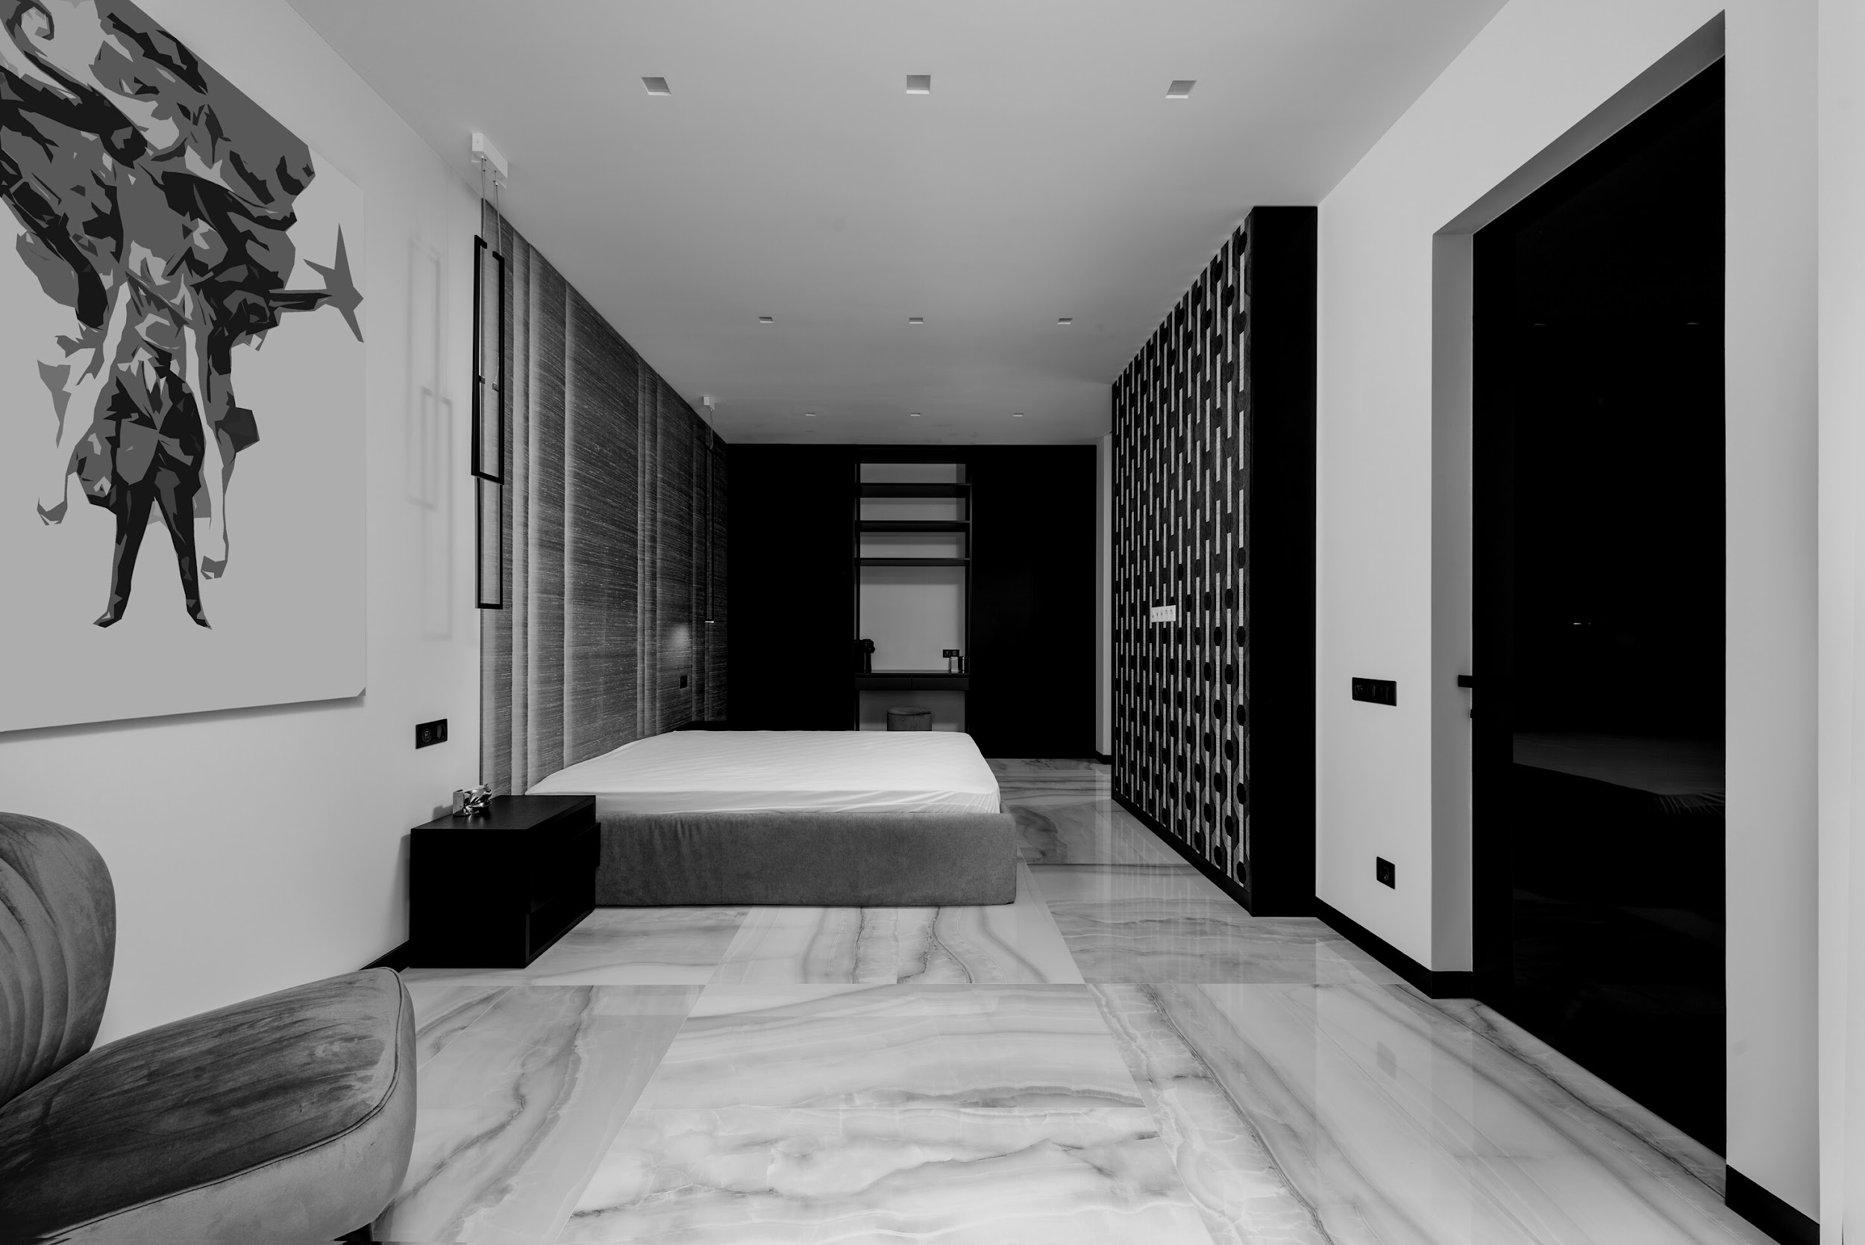
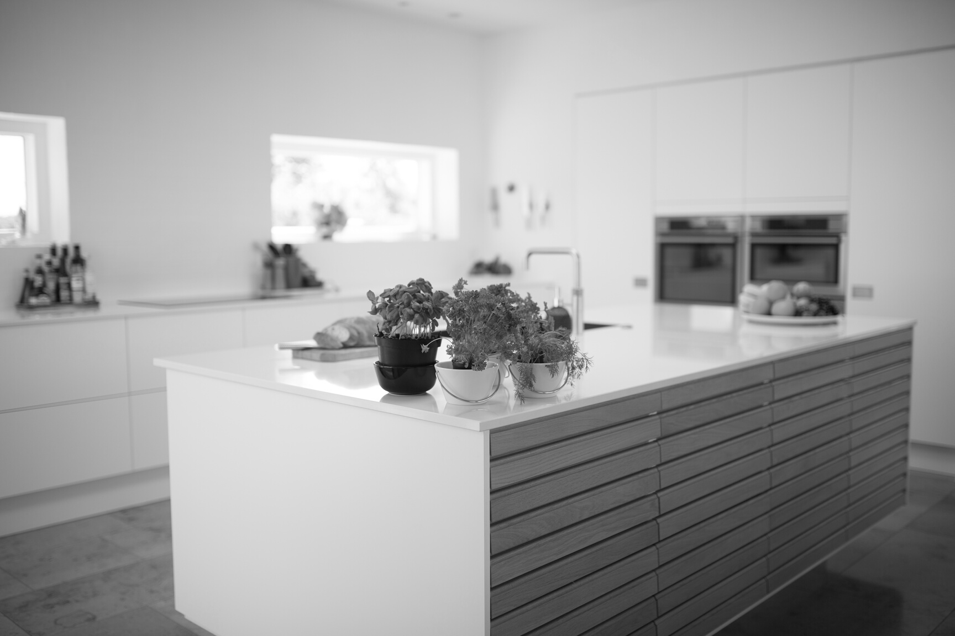
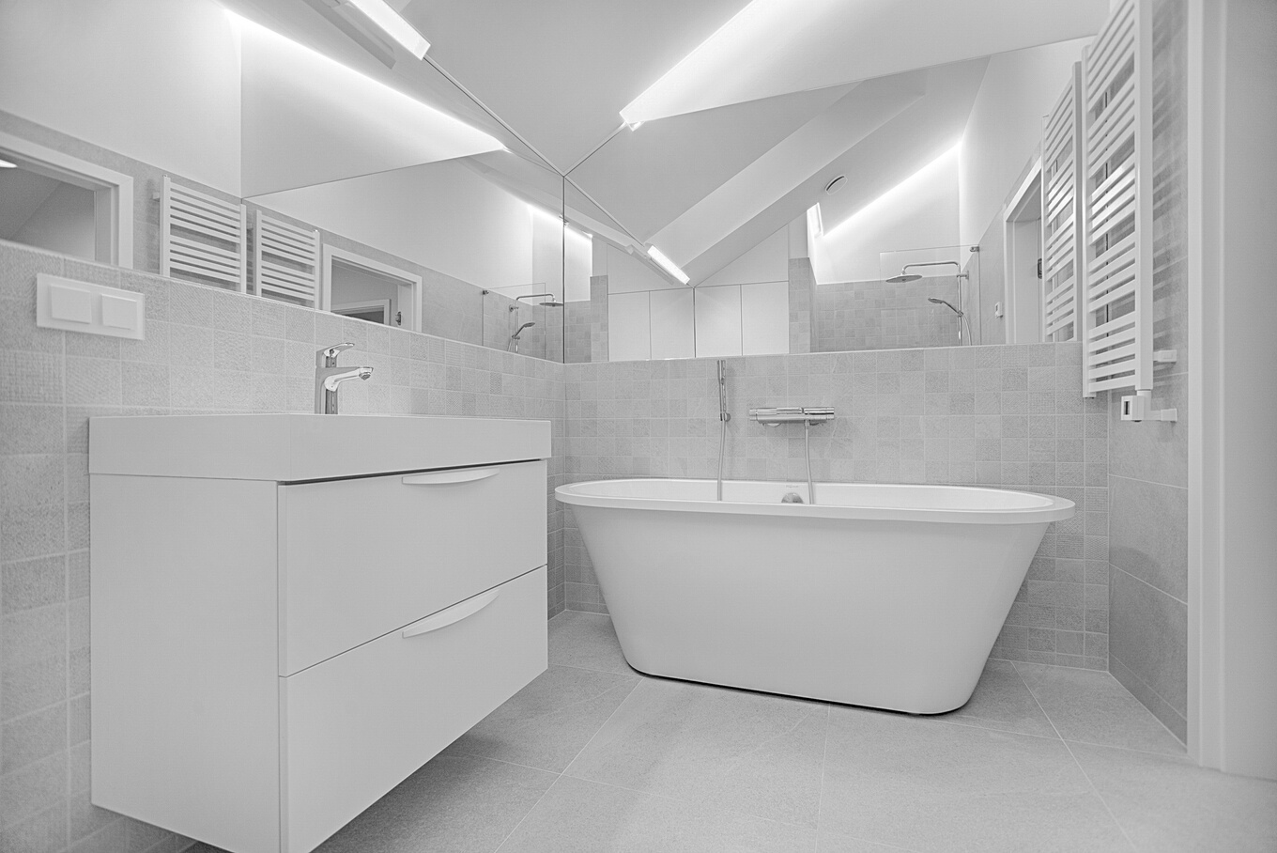
/NO.
Deliveries
Schedule.
Step 1
Step 2
Step 3
Mentor's
review
Step 3
Client
Review
Brief meeting
from your mentor
Concept Board
1 Concept Board
1 Layout
3D perspectives
1 Concept Board
1 Layout
3D perspectives
Time varies
Time varies!
[DATE]
[DATE]
[DATE]
[DATE]
[DATE]

Slide 8
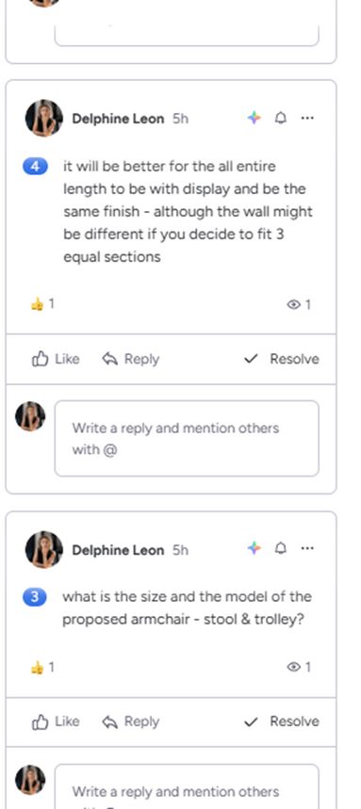

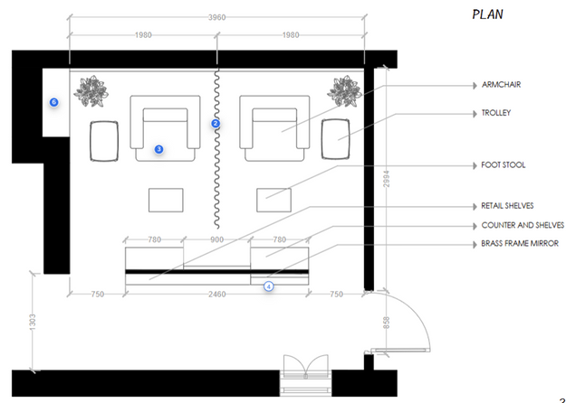

/NO.
How do you access your project board and communicate with your mentor?
You should have received an invitation from Monday.com to open a free account. Check your spams if you did not.
Review the YouTube video sent to you by email.
Project Brief | DD MM YYYY

Slide 9

/NO.
Project
Description.
Must.
Your presentation needs to strictly follow the order of the following slides
Use www.ilovepdf.com to compress your PDF presentation
Do not upload a file bigger than 10MB
It is compulsory to have rendered perspectives for versions 1.2 & 2.2
Project Brief | DD MM YYYY

Slide 10


/NO.
Method.
Methodology is key!
To build your own concept you need to start with a proper understanding of the Client and the Context.
Start with a research:
on XXXX By Admin
on XXXX By Admin
on XXXX By Admin
Project Brief | DD MM YYYY

Slide 11
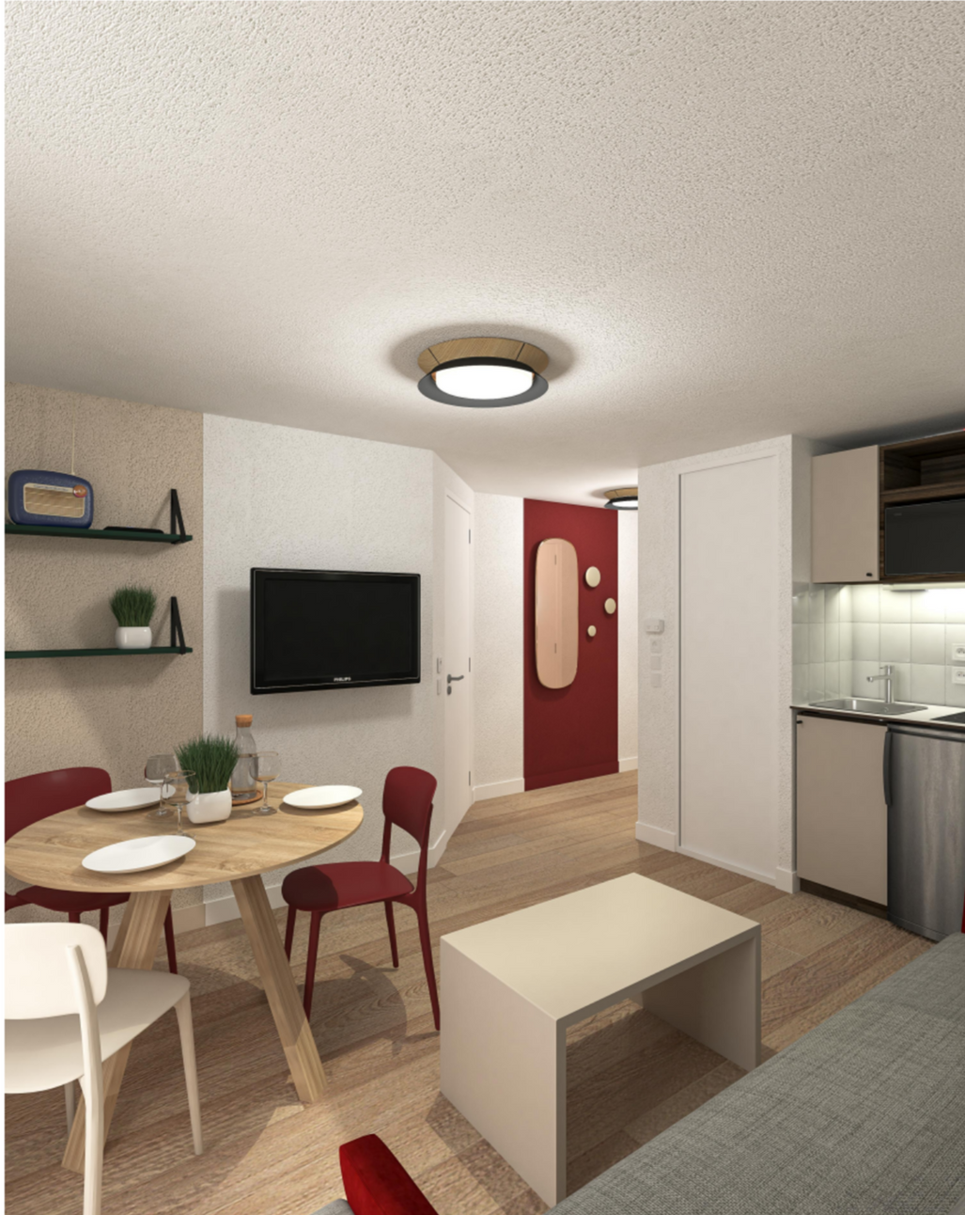
/NO.
Project Title
Your Name
Date of submission
Submission number ( ex: 1.1 - 1.2 - 2.1...)
Project brief | DD MM YYYY
www.thelivedesignproject.com

Slide 12
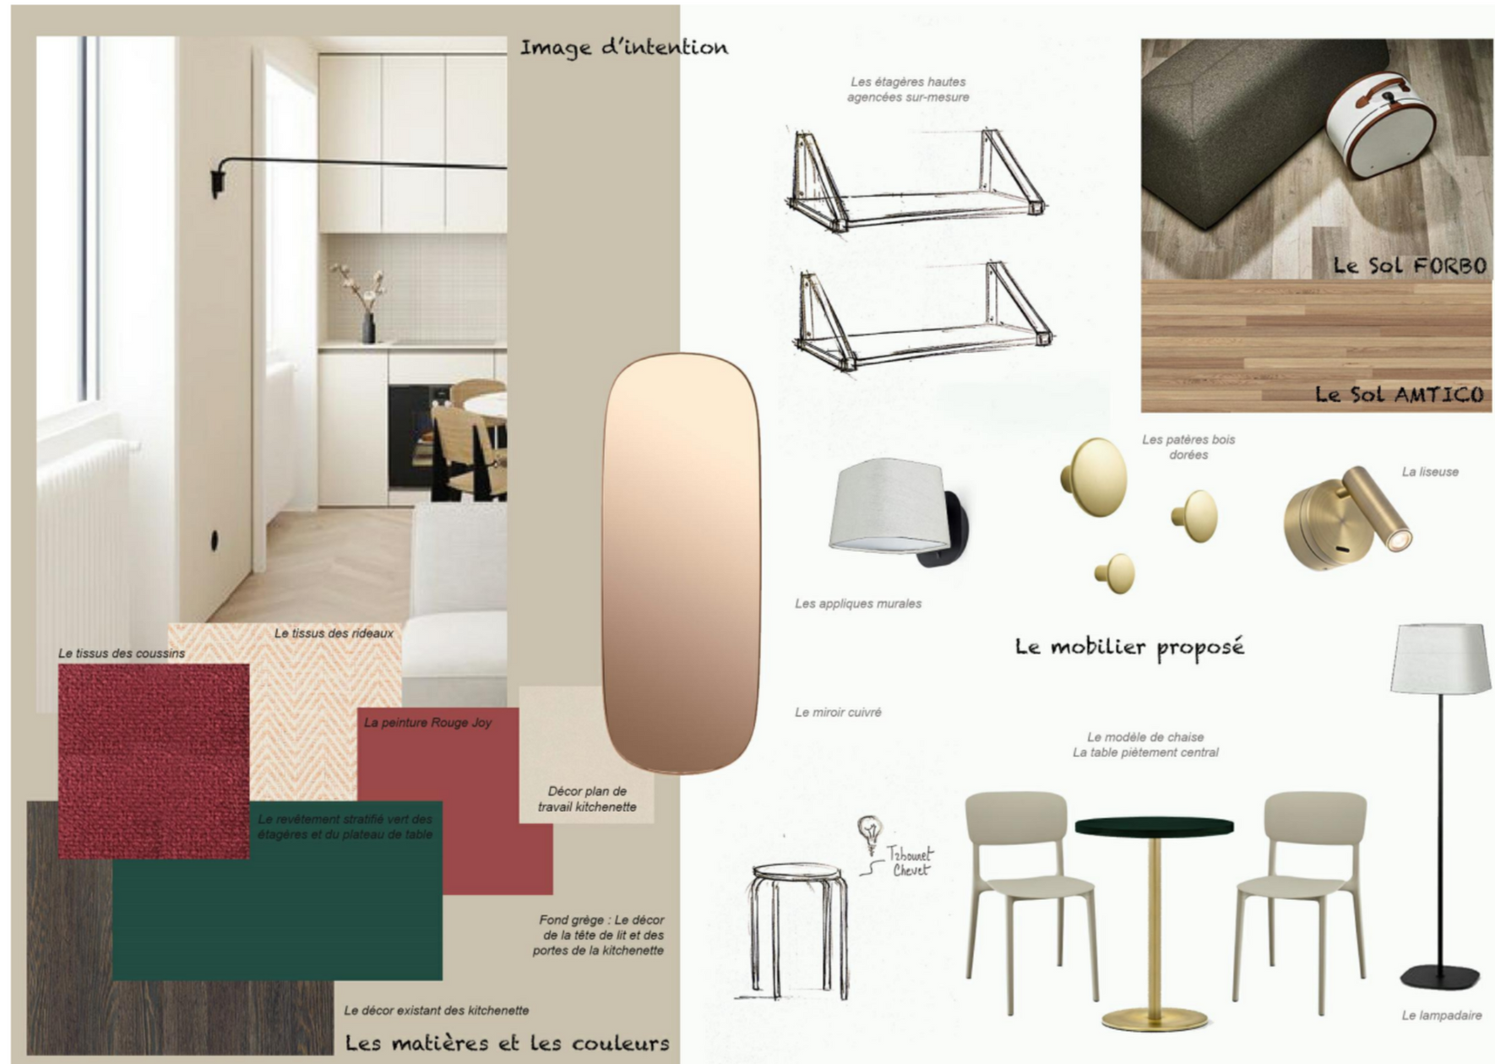
Concept
/NO.
Explain your concept in short sentences.
This is the story that Client will have to see translated into their project.
It can be a combination of inspiration images and selected furniture & finishes.

Slide 13
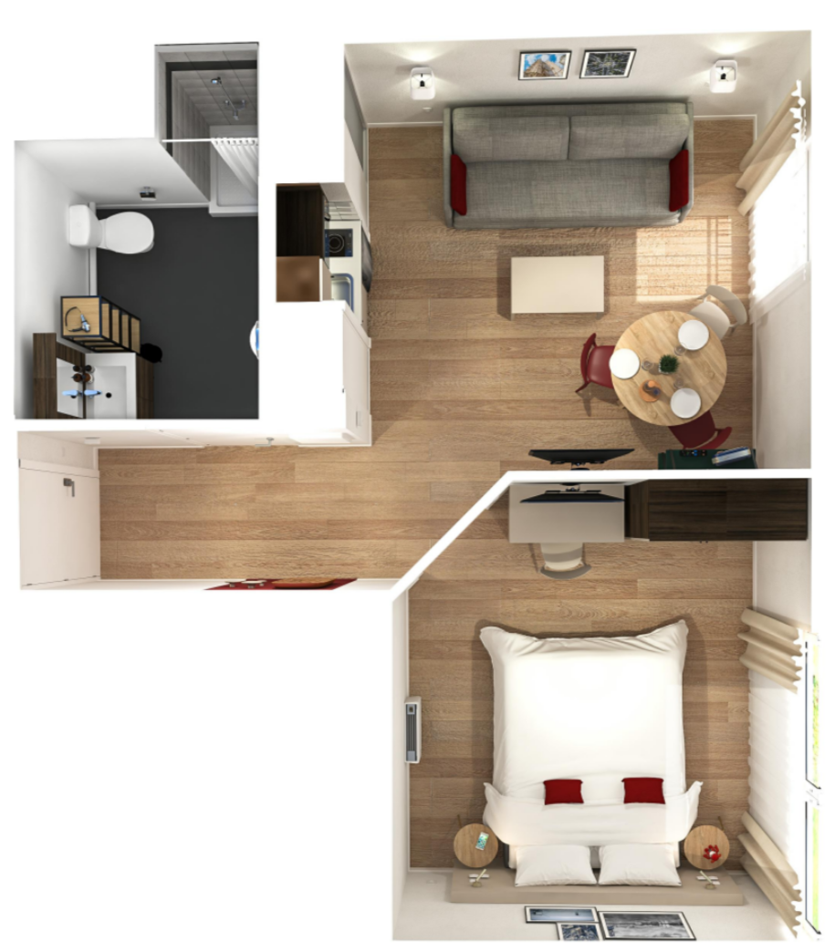
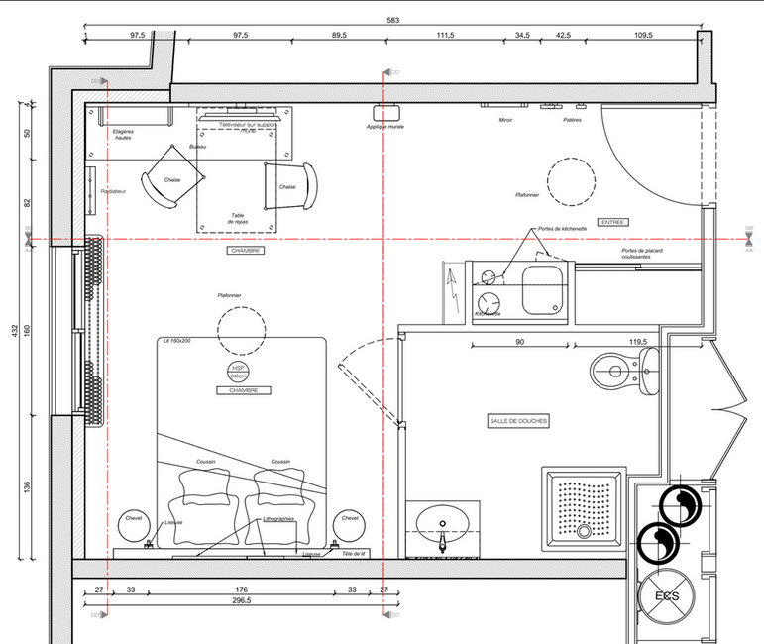
New Layout
/NO.
Explain your layout if needed
Need to show finishes & all sizes

Slide 14
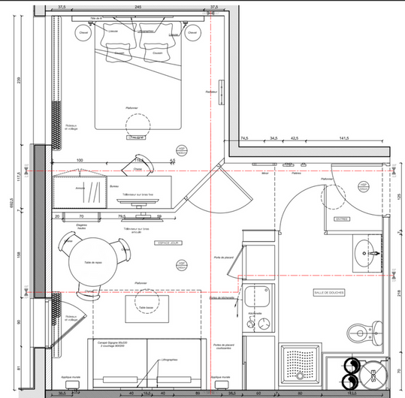
View 1
/NO.
Add any comment that you think will be relevant for the client’s understanding.

Slide 15
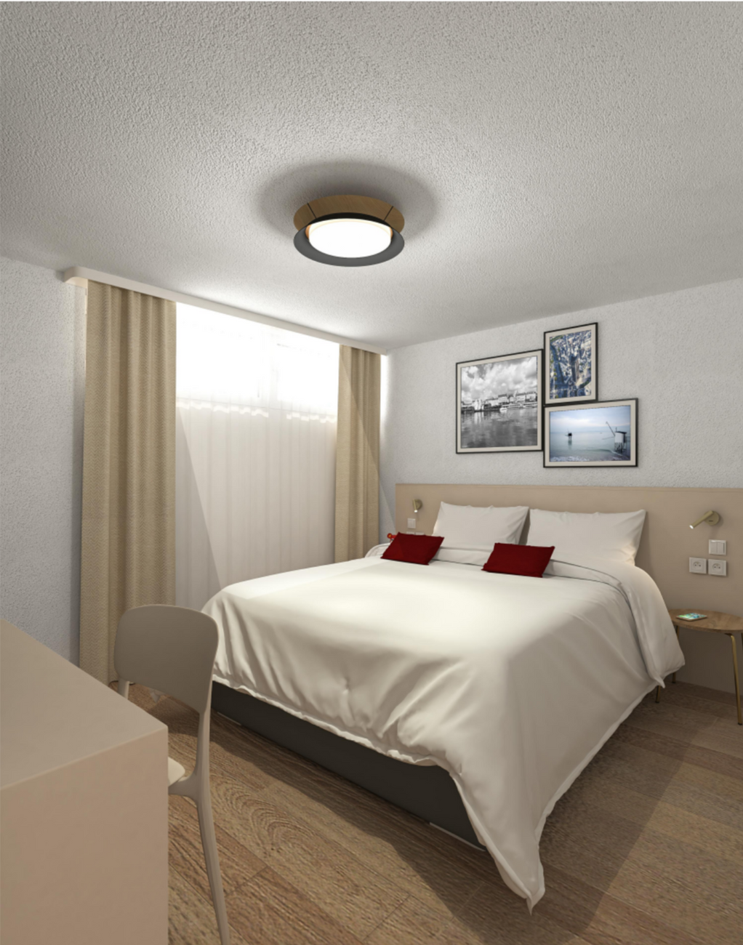
View 2
/NO.
The more views the better!
3D renders for Client’s submission is compulsory.

Slide 16



/NO.
Only the Winner will work on Phase 3.
You do not need to prepare FF&E list in an Excel format on the versions of phases 1&2.
Yet it is highly recommended to show selected FF&E to the Client as early as possible. The more detail you give, the better they can comment. The more chances you get to win.

Slide 17
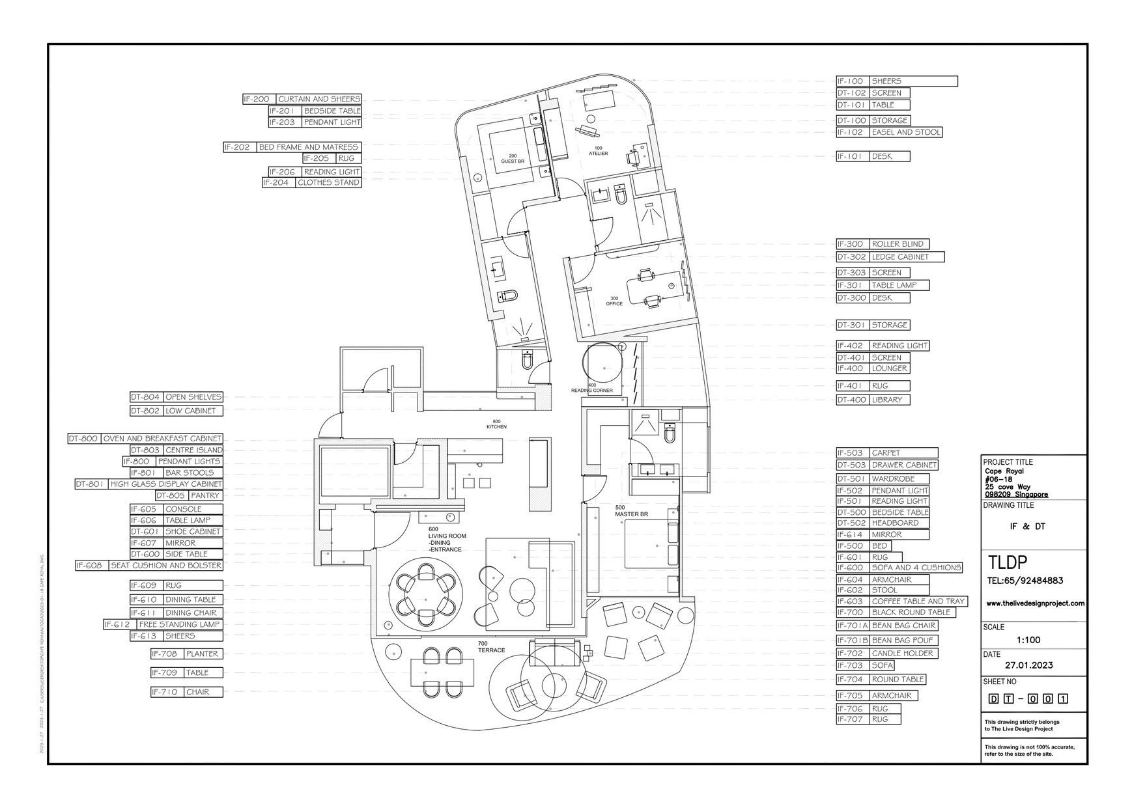
/NO.
FF&E
Layout.

Slide 18
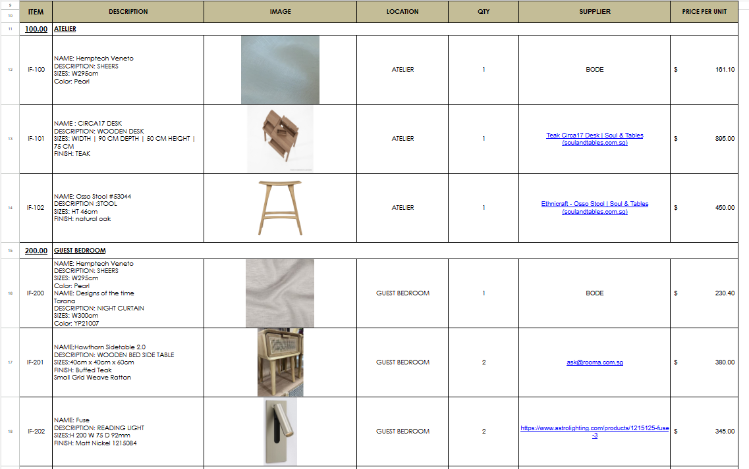
/NO.
FF&E
List.
All items should be listed
IF - Loose Furniture
FN- Finishes
EQ - Equipment

Slide 19
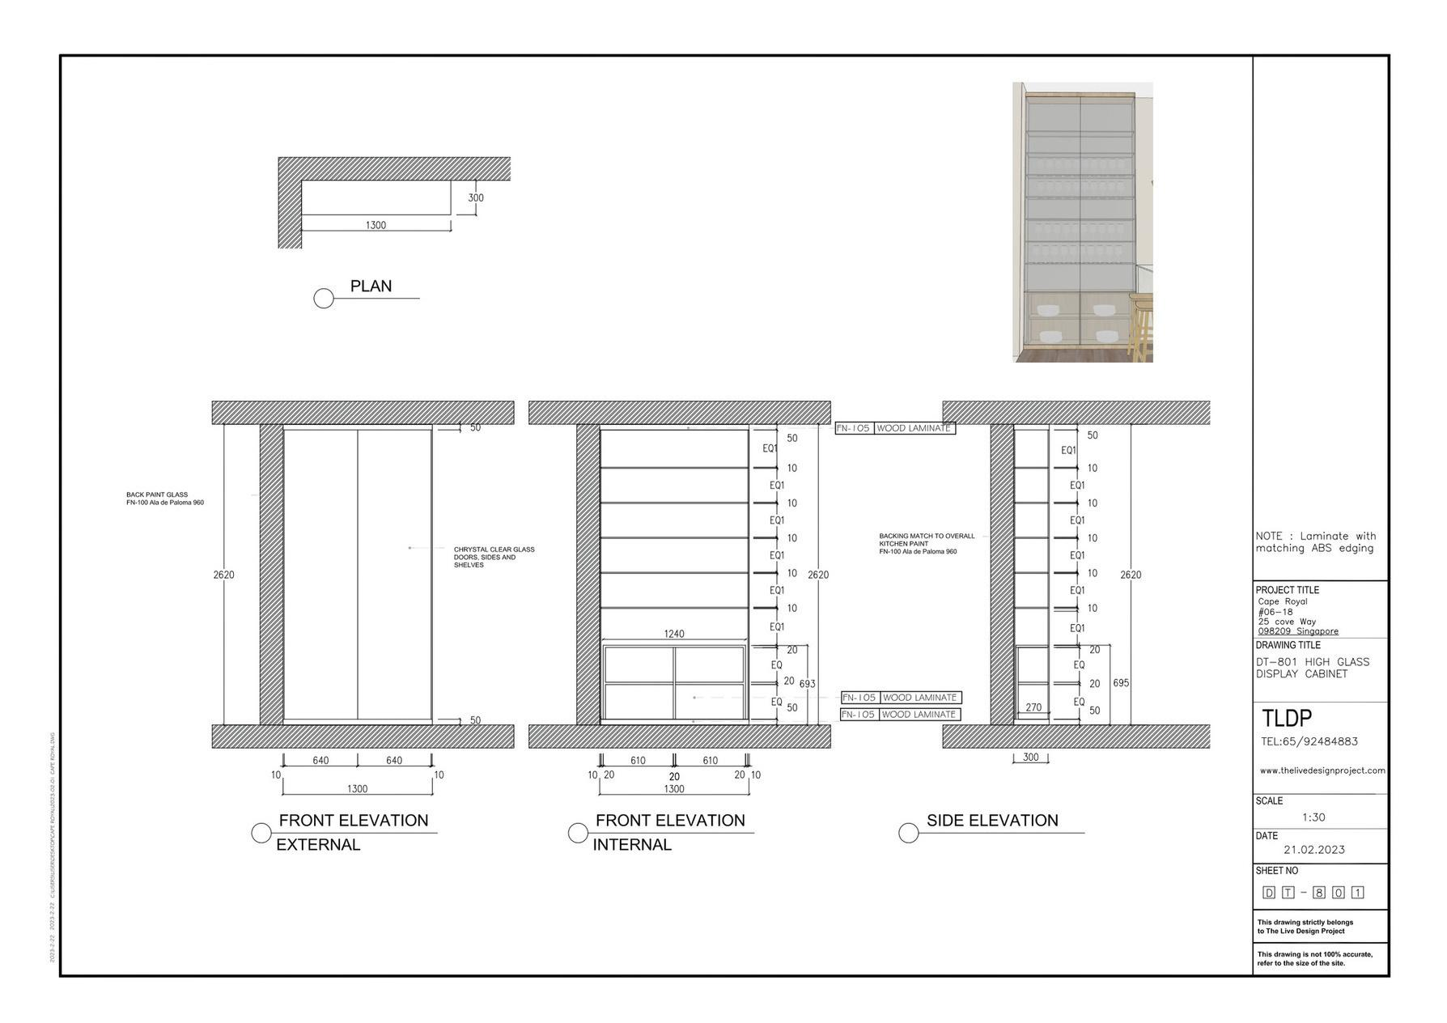
/NO.
Detail
drawing.

Slide 20
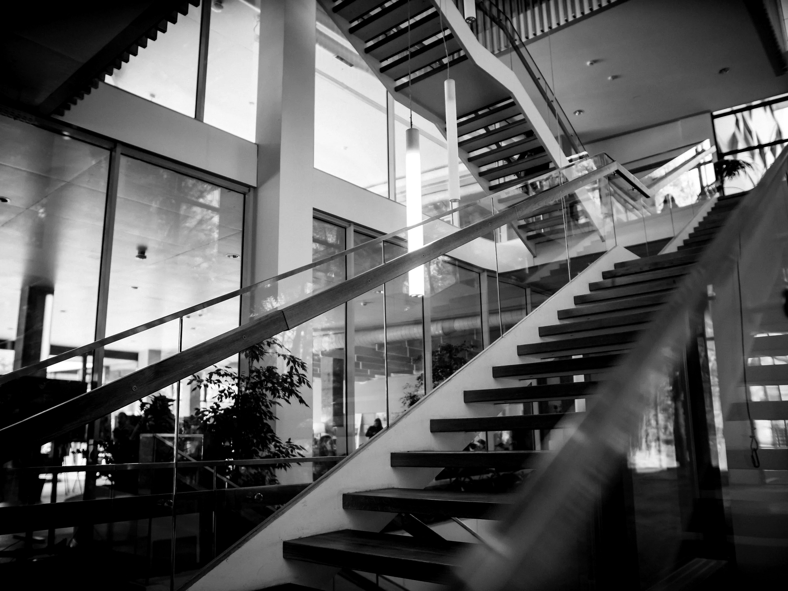
/NO.
All the best!
Estelle Darcy
Studio
Project brief | DD MM YYYY
www.thelivedesignproject.com

Slide 21
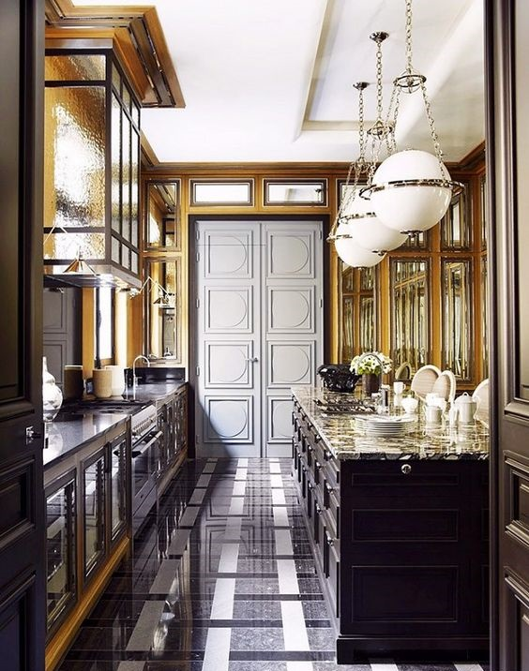
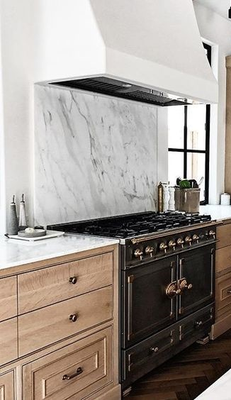
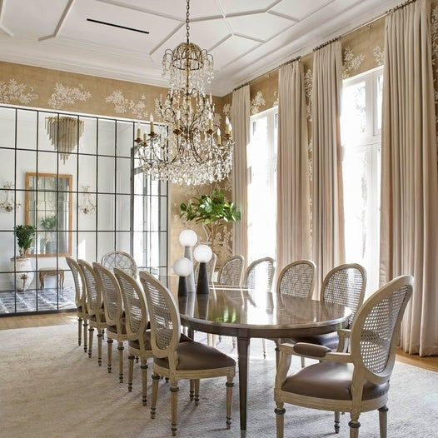
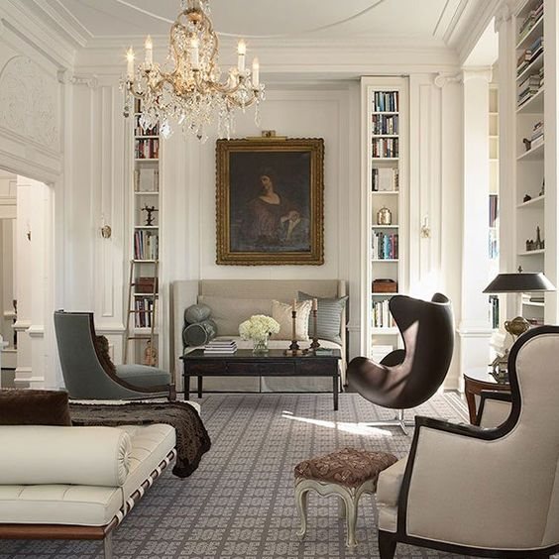
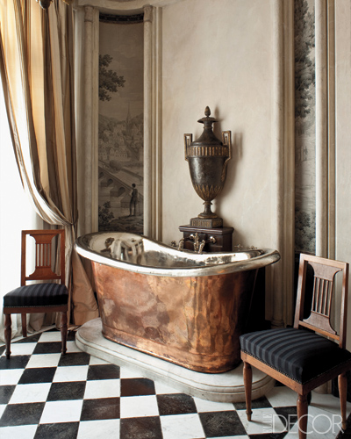
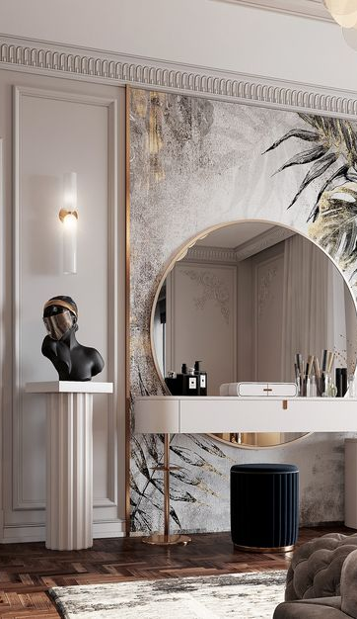
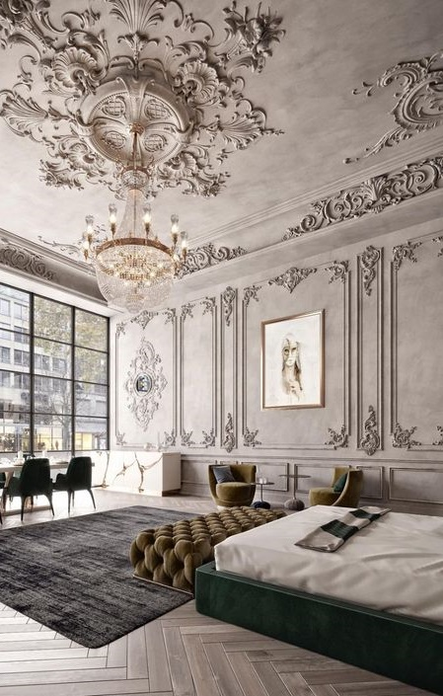
/NO.
Traditional
Traditional interior design is typically evocative of classic European decor. Hallmarks of this style generally include deep wood tones, architectural details, and elegant furnishings. This style is quite versatile, structured and balanced, rich in accessories, texture and finishes and can be combined with other interior elements to create a unique look in a room.

Slide 22
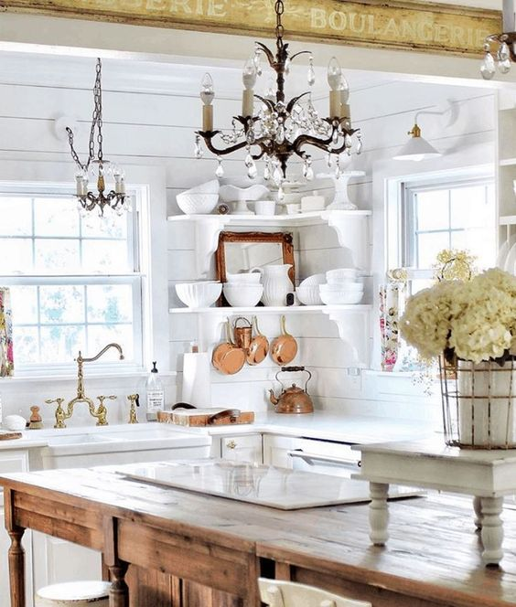
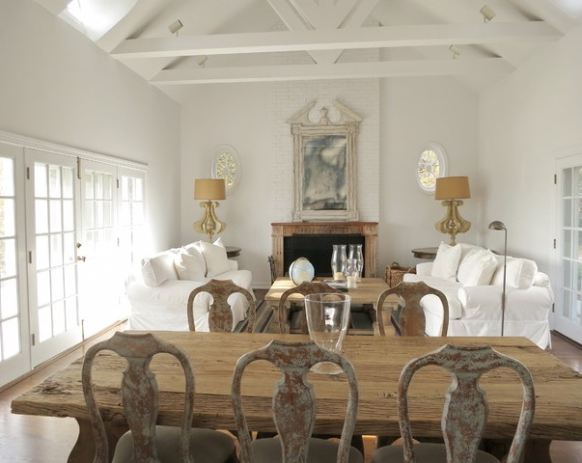
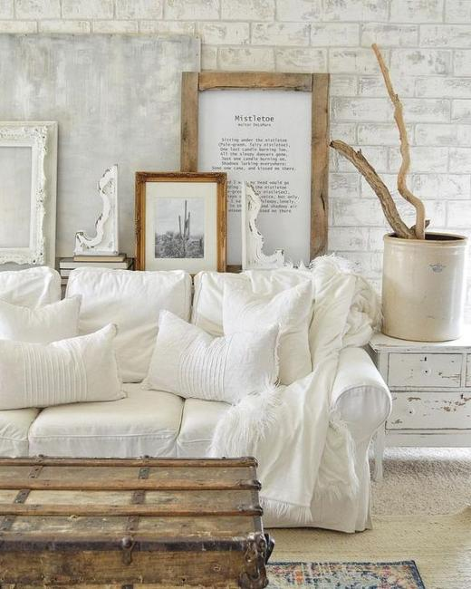
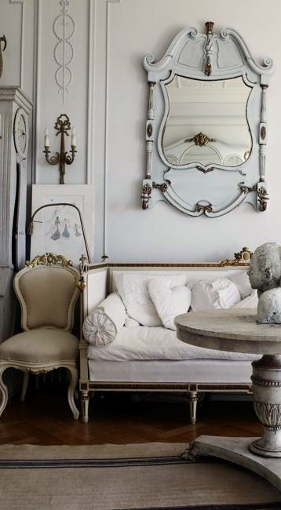
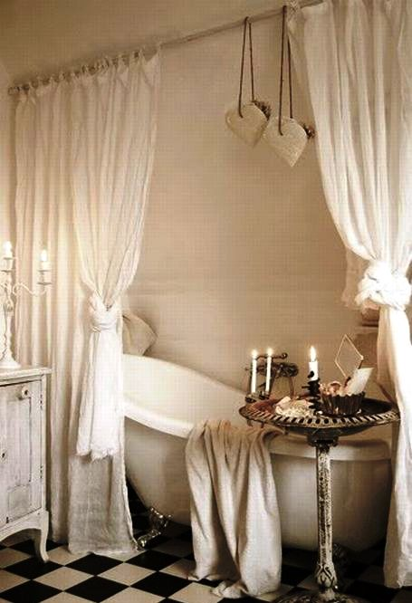
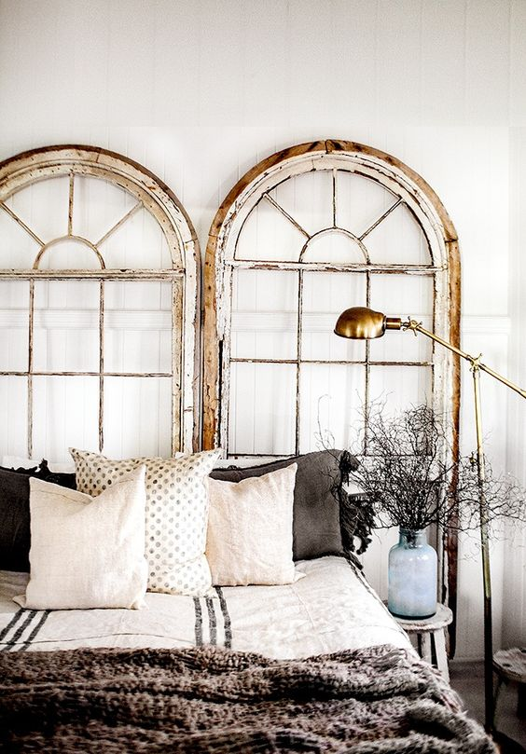
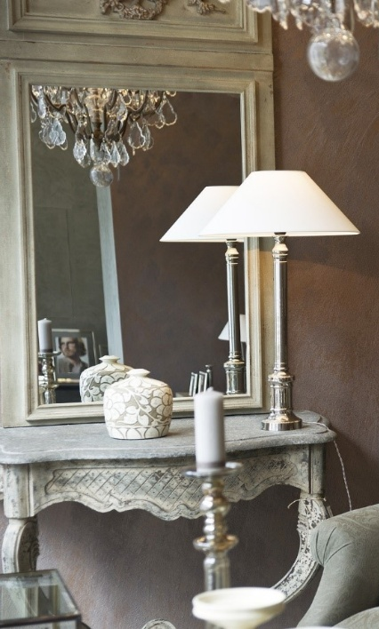
/NO.
Shabby Chic
Shabby chic interior design captures elegance and comfort in one cosy setting. Originating in the 18th century, but only coined “shabby chic” in the 1980s, this interior trend has become timeless. Rustic furniture, show off mixed collectibles and accessories packed full of character and personality, layers of comforting materials give the “shabby chic” beauty. Light stormy grey, off-white, white and tones of beige make the ideal backdrop.

Slide 23
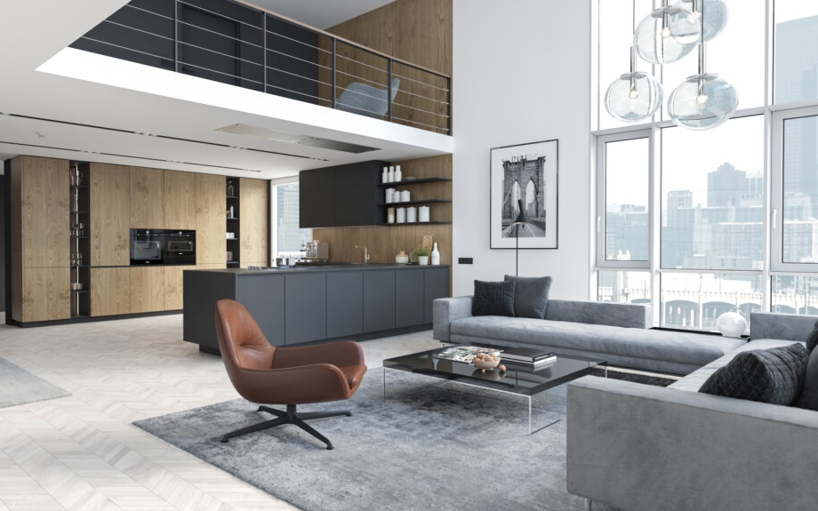
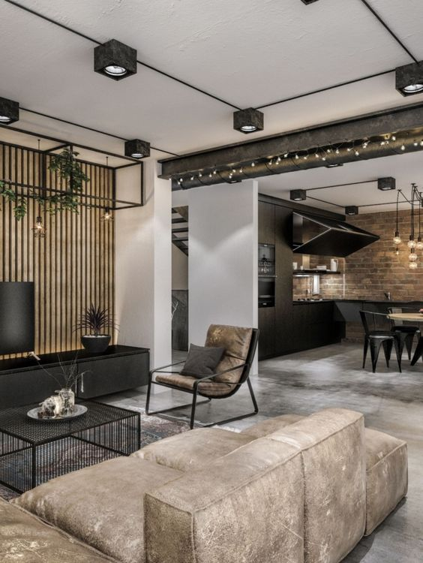
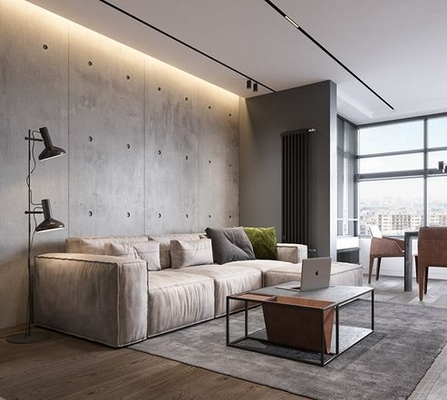
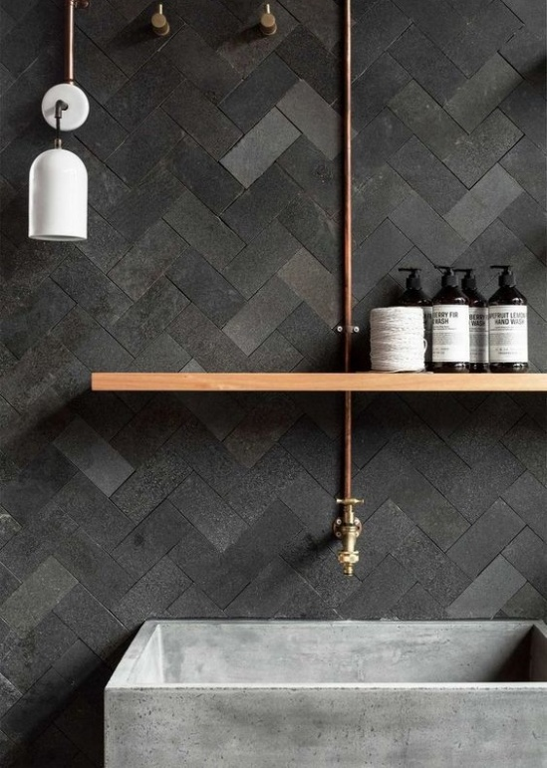
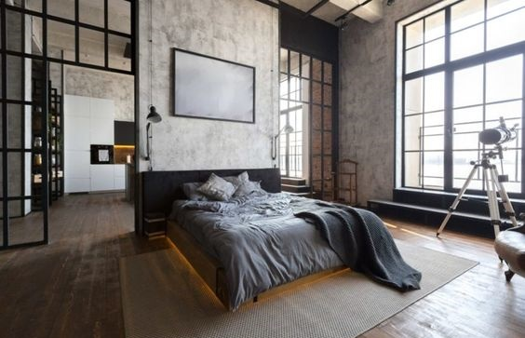
/NO.
Urban
Urban interior design blends elements of contemporary, modern, and industrial designs to create a functional unique style for inner-city living. Having a softer, more comfortable look than industrial design styles, urban design embraces warehouse conversions and loft environments as its foundation keeping untouched brick or concrete walls, using glass, wood, metal, plastic and leather. The interior uses only white, black, grey and beige basic colors.

Slide 24
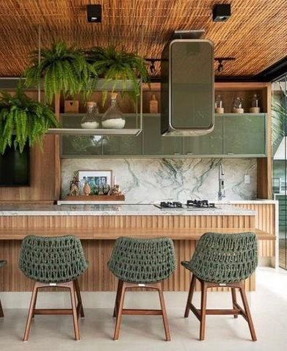
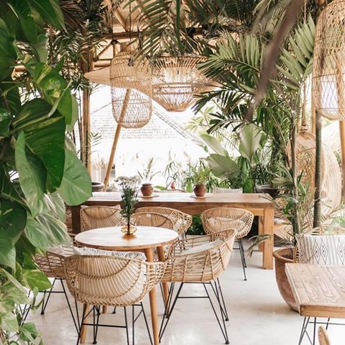
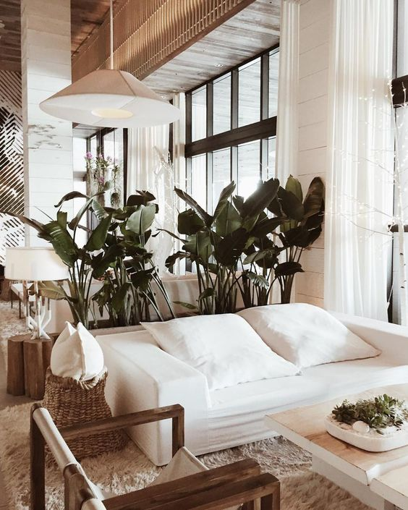
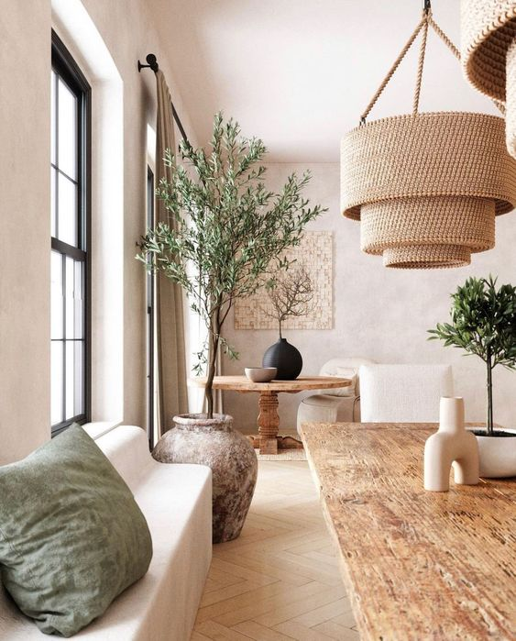
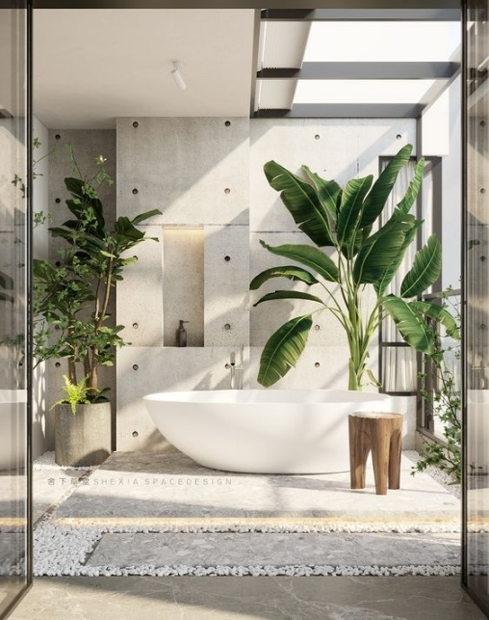
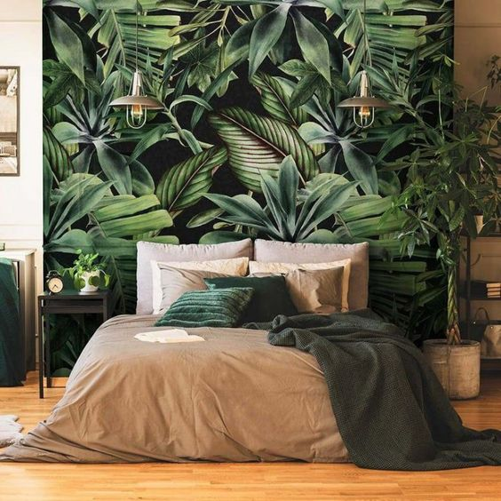
/NO.
Tropical
Tropical style is all about casual, relaxing atmosphere with a resort-style feel, comfort , ease and utility and is eclectic by definition. The style is characterized by warm and soothing, colours drawn mostly from natural elements such as the sea, sky, and vegetation. Hues may be deep and rich or may fall on the lighter, brighter side.
Tropical modern combines the clean lines and muted colour palette of contemporary design with the exotic woods and stone found in island homes.

Slide 25
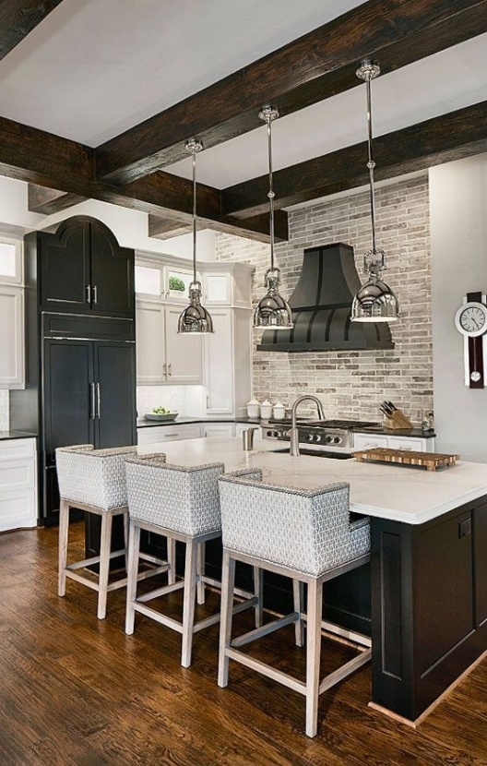
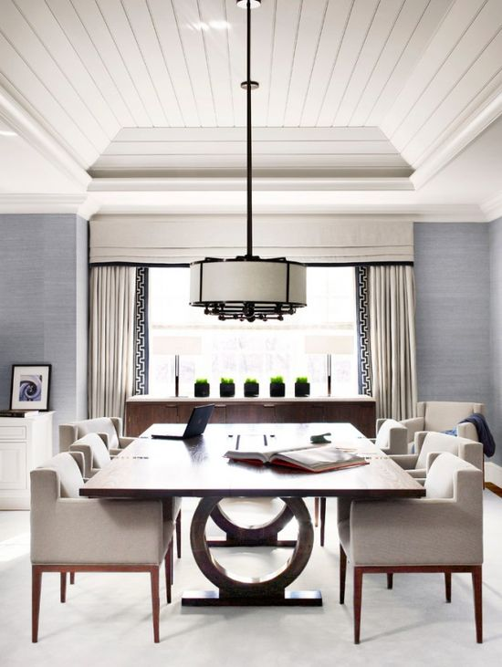
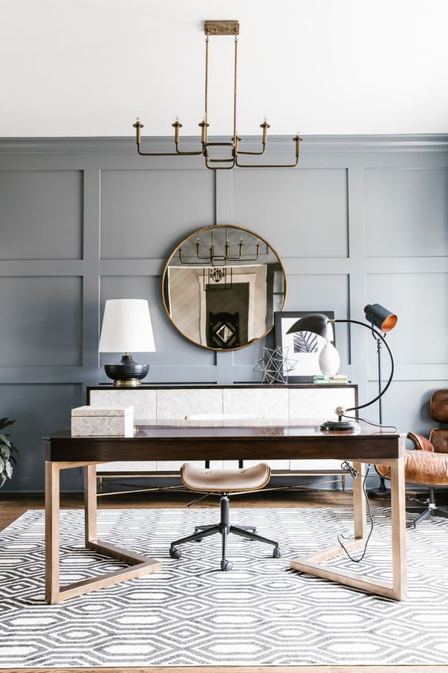
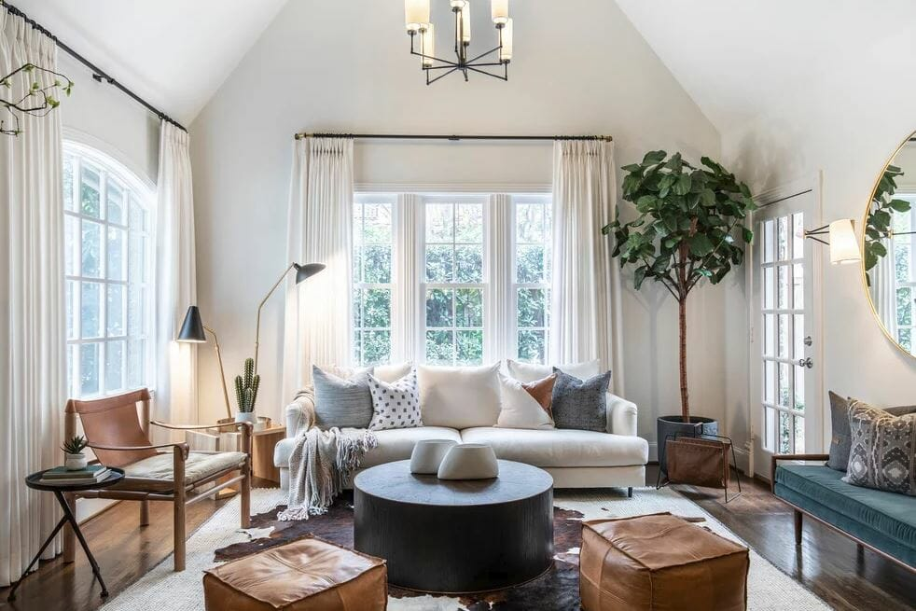
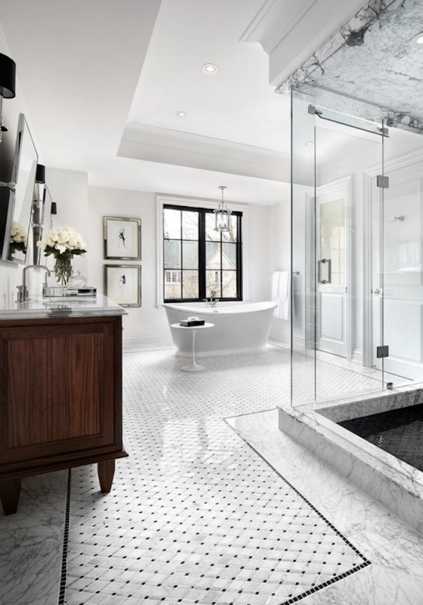
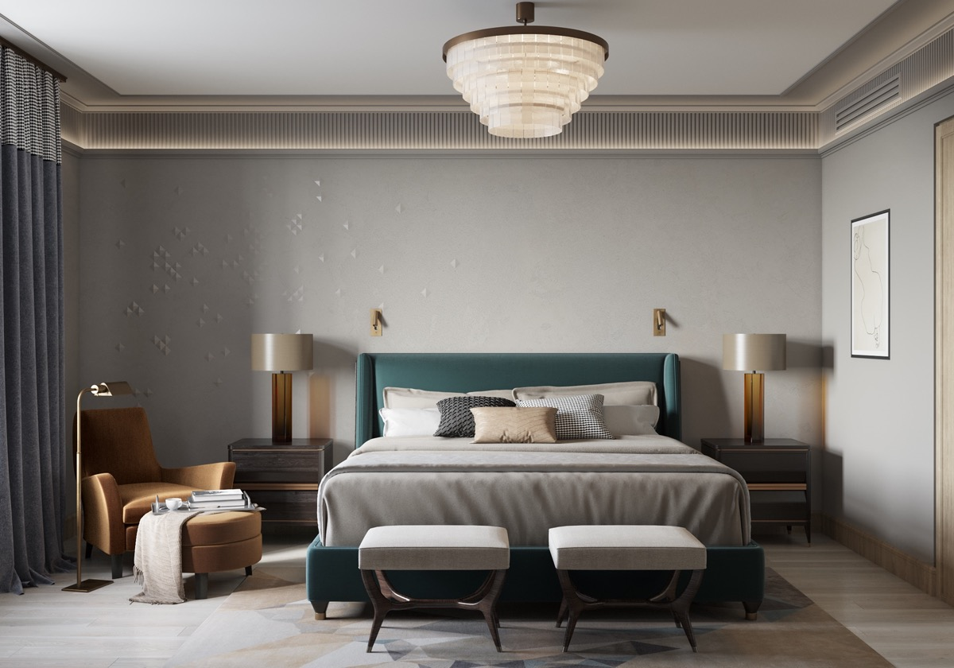
/NO.
Transitional
Transitional design is a balanced blend of the traditional and contemporary styles, elegant and timeless that combines curves with straight lines to create a design that balances masculine and feminine attributes, aiming to create a comfortable and relaxing style.
The hallmarks of transitional style include a neutral colour palette with colour in art and accents rather than upholstery and floors, organic textures, minimal artwork and accessories, and comfortable furniture.

Slide 26
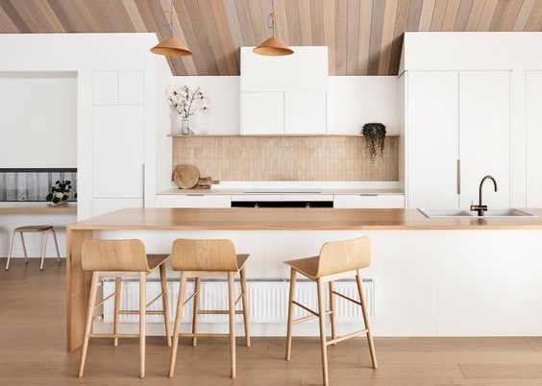
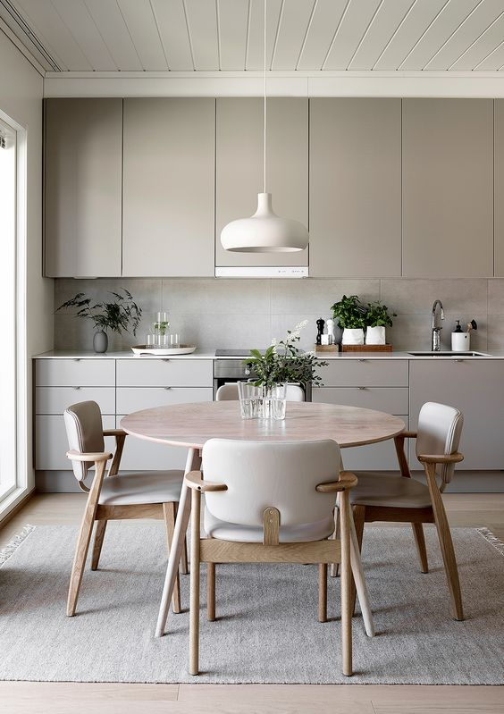




/NO.
Scandinavian
Scandinavian interior design is a minimalistic style using a blend of textures and soft hues to make sleek, modern décor feel warm and inviting. It emphasizes clean lines, utility, and simple furnishings that are functional, beautiful, and cosy.

Slide 27







/NO.
Rustic
Rustic interiors are defined by ruggedness, texture and letting natural, aged, organic beauty shine. The focus is to create a relaxing welcoming atmosphere by highlighting the use of real wood, stone, leaves, and other organic elements.
Natural, neutral colours such as warm tints of beiges, whites, browns, and greys are all key.
The focus of rustic should be on the material, not the design, so many pieces are incredibly simple.

Slide 28





/NO.
Minimalist
Minimalist interior design is characterized by using the base essentials to create a simple and uncluttered space. It uses simplicity, clean lines, and a monochromatic colour palette with accents in the accessories and the different textures. “Less is more” Ludwig Mies van der Rohe.

Slide 29






/NO.
Modern
Modern design is an interior design style characterized by a monochromatic colour palette, clean lines, minimalism, natural materials, and natural light. It refers specifically to a historical aesthetic movement that took place during the early to mid-twentieth century.

Slide 30





/NO.
Mid-Century
Elements of mid-century modern interior design include clean lines, muted tones, a combination of natural and manmade materials, graphic shapes, vibrant colours, and integrating indoor and outdoor motifs.

Slide 31







/NO.
Industrial
Industrial style or industrial chic refers to an aesthetic trend in interior design that takes clues from old factories and industrial spaces that in recent years have been converted to lofts and other living spaces. The essential elements of this style are exposed pipes and ducts, wood & metal combined, daring brick walls, concrete floors, vintage furniture & accessories, radiating light fixtures and earth-tone colours.

Slide 32







/NO.
Eclectic
Eclectic interior design is a style that artfully mixes elements of multiple design styles from different time periods into one space. It involves an informal mix of furnishings and décor, prints, patterns & textures carefully curated. Often, eclectic decor combines bright colours and patterns and mixes in unexpected elements.

Slide 33





/NO.
Country
Country-style design refers to a broad style of home design, drawing their inspiration from traditional barn, cabin, and farmhouse designs which reflects the importance of people and gatherings, creating a cosy and nostalgic feeling that turns a house into a home. These homes are made with natural materials, particularly wood, celebrating the life outdoors. The colour palette incorporates pastels and bright colours.

Slide 34





/NO.
Contemporary
Contemporary style refers to “of the moment,” and does not encapsulate a specific philosophy of design but is instead a blanket term given to describe the interior design trends of today, while paying homage to the past. Dating back to the 1970’s, contemporary style is truly unique as it borrows elements from several other design styles.

Slide 35








/NO.
/01
Art Deco
Art Deco, short for Arts Décoratifs style of the 1920s and '30s combined modern styles with fine craftsmanship and rich materials such as ebony and ivory. It was influenced by the bold geometric forms of Cubism and the Vienna Secession; the bright colours of Fauvism and of the Ballets Russes; the updated craftsmanship of the furniture of the eras of Louis Philippe I and Louis XVI; and the exoticized styles of China, Japan, India, Persia, ancient Egypt and Maya art.

Slide 36








/NO.
Coastal
Coastal design is exactly what it sounds like: a design style that is all about that seaside aesthetic that makes a home feel like a high-end island getaway. With soothing blue hues, beachy décor like driftwood, natural fibres, and weathered wood furniture, coastal design is classically calming, laidback yet chic.

Slide 37





/NO.
Asian Zen
Asian Zen interior design focuses on emphasizing a sense of harmony, balance, tranquillity, and. It draws inspiration from both the concept of Zen and the importance of incorporating nature into your décor, neutral and earthy colours, especially beiges and browns.
More contemporary zen styles may veer towards white and black colour schemes. Since zen is all about relaxation, the soothing tones of neutral colours typically dominate.

